Slide 1
Robot Operating System:
How to pitch a
Robot’s Brain?
A DEEP DIVE ON EFFECTIVE MARKET CAMPAIGN STRATEGIES FOR HIGHER ROI ON THE ROS

Slide 2
TABLE OF CONTENTS
01
05
Case study - A brief summary
Statistical testing
02
06
Data description
Insights & Recommendations
03
07
Data pre-processing strategies
Data challenges
04
08
Exploratory Data Analysis
Conclusion

Slide 3
”Key considerations when choosing a robot’s operating system”
“Securing ROS robotics platforms”
“Docker & ROS: When all you have is a hammer, everything looks like a nail”
“ROS Support”

Slide 4
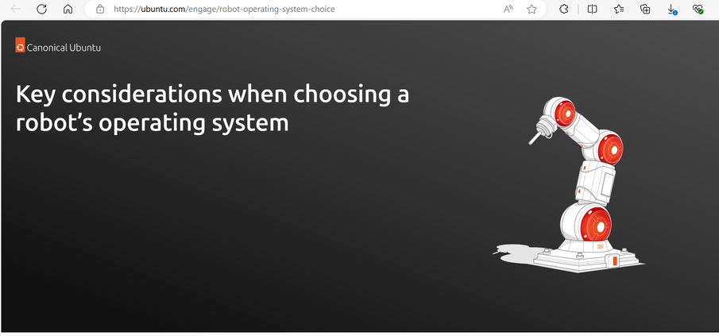


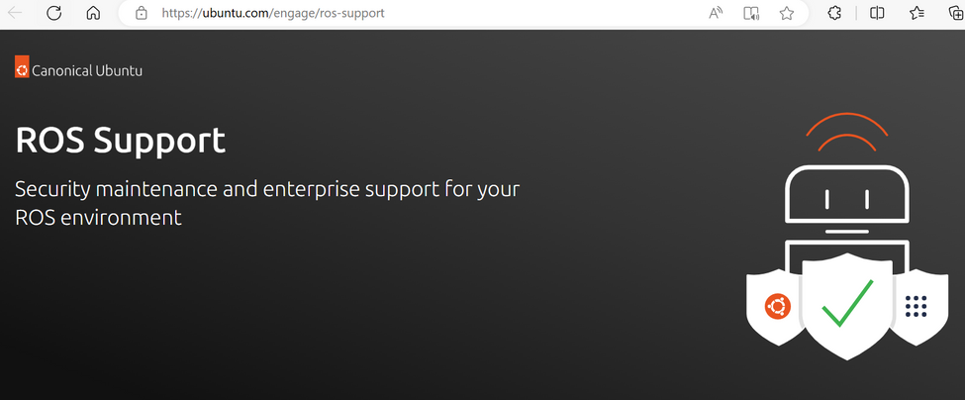
MEET THE CAMPAIGNS
C1 - FY19_IOT_Robotics_Whitepaper_OSconsiderations
C2 - CY20_IOT_Robotics_Whitepaper_ROSonrobotics
C3 - CY21_IOT_Robotics_T1_WP_ROSDocker
C4 - CY21_IOT_Robotics_Whitepaper_ROSESM

Slide 5
BACKGROUND
Explore the effectiveness and outreach of 4 marketing campaigns with respect to a Robot Operating System whitepaper.
Aims to establish standard metrics of evaluation for gauging campaign effectiveness.
Uncover primary factors that influence market growth in terms of views, leads and conversions for each campaign strategy.
Suggest strategies to improve gray areas in data collection to enhance future campaign planning.

Slide 6
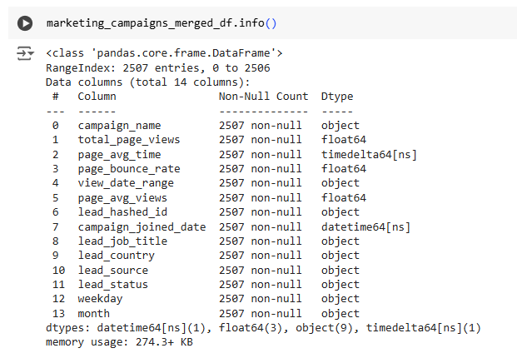
A GLANCE AT THE DATA
3 datasets for 4 marketing campaigns in form of Campaigns, Pages and Leads.
Each row of Pages dataset corresponds to page related information (e.g. - when a user viewed a campaign page, no of times a page link is visited, etc.)
Each row of the Leads dataset corresponds to leads’ specific details (e.g. - when a user joined a campaign, lead status, campaign name, etc.)
9.2% data in foreign languages (lead_job_title, industry, source, country, etc.)
50,410 total page views across 354 distinct page viewing dates for all campaigns.
2540 total leads spanning 263 unique campaign joining dates from 117 countries for all campaigns.
Missing data ranges from 1% to 80% in some columns, after cleaning and merging - 2507 rows and 14 columns (1.3% loss, 2540 rows earlier).

Slide 7
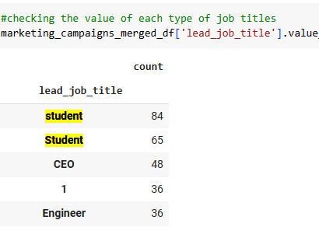
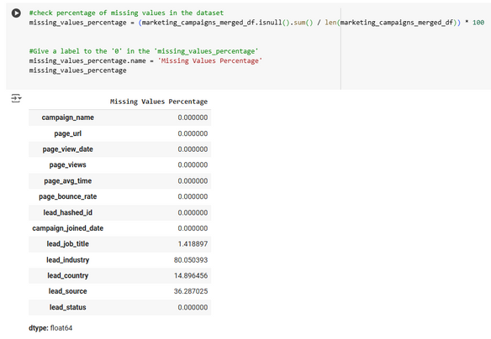
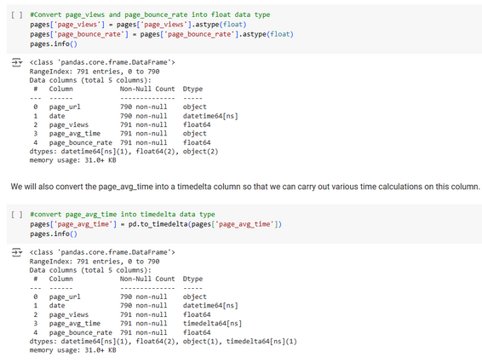
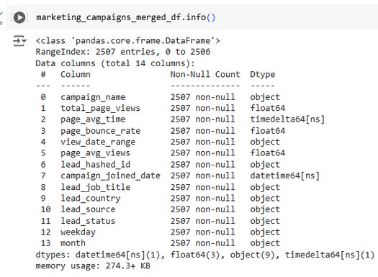
DATA PREPROCESSING STRATEGIES
Data cleaning & prep
Missing values
Format datatypes
Feature Engineering
Merging 3 datasets on basis of Campaign_name field ensuring no duplication.
Removed commas and unnecessary characters from campaign_names.
Corrected inconsistent values (‘Doctor’ to ‘Dr.’, ‘STUDENT’ to ‘Student’, etc).
9.17% of foreign language texts.
Missing value columns all from LEADS dataset - lead_job_title, country, source, industry.
Dropped lead_industry column with 85% missing data.
Removed 1.3% of rows with ‘NaN’ for lead_job_title column.
Imputed with ‘Unknown’ value for country and source columns with 15-36% missing fields.
Modified the date columns to have DateTime format.
Converted columns with Time information into TimeDelta datatype (eg- page_avg_time).
Converted specific Object cols to appropriate types.
Added ‘weekday’ and ‘months’, extracted from Date columns.
Dropped page_url column from merged dataset.
Added numerical columns for specific categorical columns for statistical analysis part.

Slide 8
EXPLORATORY DATA ANALYSIS
Important Questions We Want To Answer:-
How long do people spend on a page on an average before bouncing off?
Which industries are producing the highest leads?
How frequently do we observe days with high numbers of conversions compared to days with low numbers of conversions?
Do more page views lead to more conversions?
Which marketing campaign is more effective in terms of conversions and effectiveness?
How many possible conversions did each lead source category result in?

Slide 9
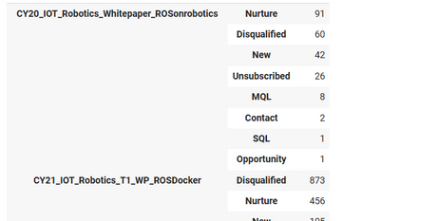
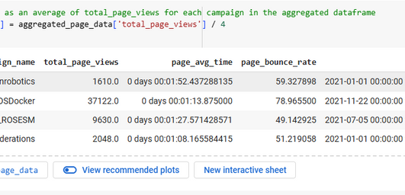
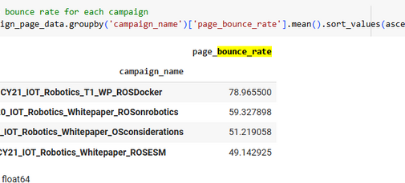
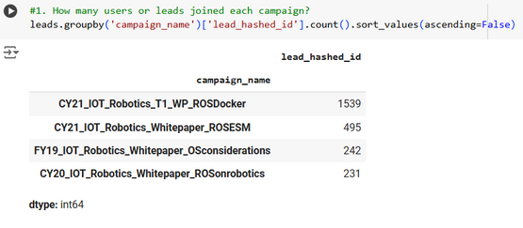
EXPLORATORY DATA ANALYSIS-FINDINGS
Top lead statuses
Avg page views/time
Average bounce rates
Highest Leads
Nurture, Disqualified
Views- 402-9280, Time- 1.52 sec
Range - 49 - 79%
Campaign wise analysis
The top statuses were ‘Nurture’ and ‘Disqualified’ for all the 4 campaigns, with CY20_IOT_Robotics_Whitepaper_ROSonrobotics and CY21_IOT_Robotics_T1_WP_ROSDocker being the only campaigns with ‘Sales Qualified Leads’ (SQL) count in the tally.
Campaign 3 or CY21_IOT_Robotics_T1_WP_ROSDocker received highest average views of 9280 views, and c2 performed the worst with 402 views.
CY20_IOT_Robotics_Whitepaper_ROSonrobotics had the highest average page view time of 1.52 mins, and c1 being the worst with 1.08 mins.
On an average, 59.66% of visitors left the page without interacting further.
CY21_IOT_Robotics_T1_WP_ROSDocker has the highest bounce rate of 79%, and CY21_IOT_Robotics_Whitepaper_ROSESM has the lowest with 49%.
Highest leads count (1539) for c3 - CY21_IOT_Robotics_T1_WP_ROSDocker, and lowest for CY20_IOT_Robotics_Whitepaper_ROSonrobotics with 231 leads.

Slide 10
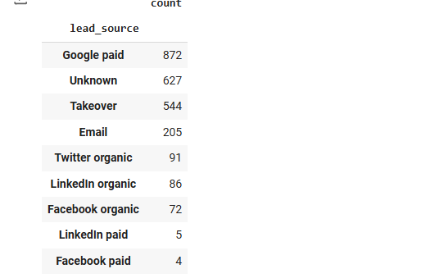
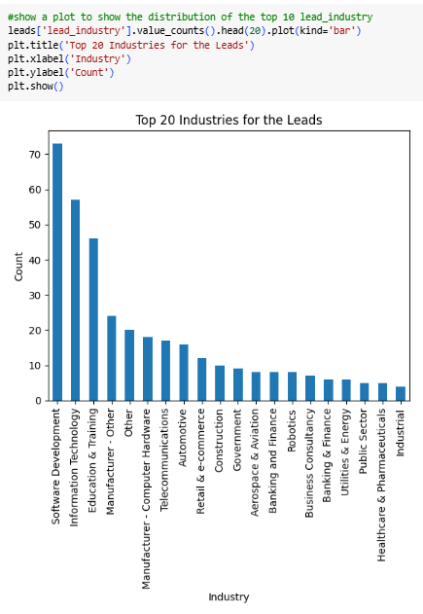
SOME NUMBERS...
Nurture, Disqualified
37122 views
top lead statuses
#1C - ROSDocker
9 unique
41 distinct
lead sources
leads’ industries
Google Paid
59.66%
Top lead source
overall page bounce rate
Software
Development
1539 highest leads
#1C - ROSDocker
Industry with highest leads

Slide 11
STATISTICAL TESTING - USE CASES
Hypothesis Testing
Cohort Analysis
A/B testing or Causal Analysis
Chi-Squared test to determine if there is a statistically significant relationship between the performances of the campaigns.
H0 (null hypothesis) - There is no difference between the performance and effectiveness of the 4 campaigns.
H1 (alternate hypothesis) - The 4 campaigns vary in performance in terms of effectiveness.
Segmentation analysis by grouping leads (cohorts) by ‘campaign_joined_date’ field to assess campaign performance as per seasonality trends.
Time-based cohorts: Group customers based on when they first joined the campaign (e.g.,campaign_joined_date).
Behavior-based cohorts: Group leads based on their initial behavior (e.g., lead source, lead_job_title).
Analyzed metrics over different time intervals (e.g., weekly, monthly in this case.
Experiment with different campaign elements to optimize results. Limited to real experimentation.
Divide campaigns into 4 groups and run the A/B test for a long enough period to collect enough data.
For multiple comparisons, performed the Bonferroni correction to adjust the significance level (p-value).
Mann-Whitney U Test and chi squared tests for non-parametric values.

Slide 12
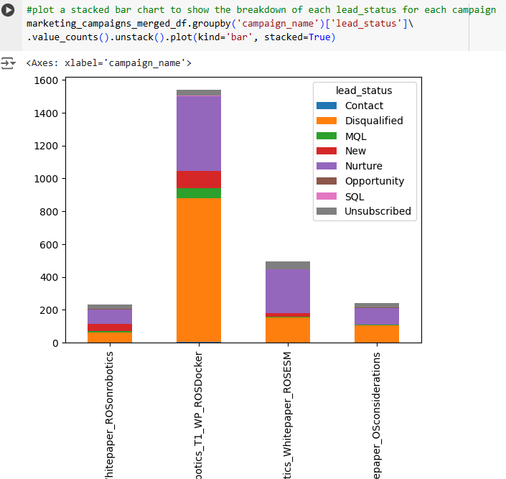
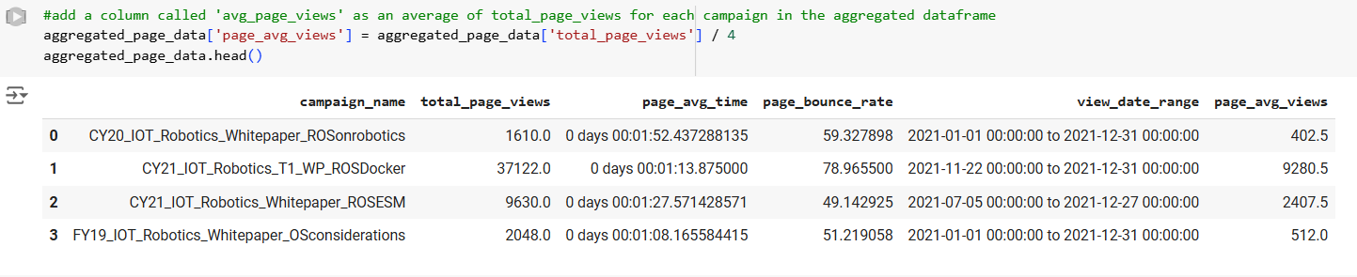
CAMPAIGN PERFORMANCE ANALYSIS
Engagement Metrics:
Page Views: Total page views - c3 > c4 > c1 > c2. Total views/campaign ranges between 1610 - 37122.
Average Page View Time: c2 > c3 > c4 > c1. Range is 1.52 mins -1.8 mins.
Bounce Rate: c3 > c2 > c1 > c4. Range - 49.14% - 78.97%.
Lead Quality Metrics:
Conversion Rate: % of convertible leads (only counting for - MQL, SQL, Opportunity) - highest secured by -> c3 > c2 > c1 > c4. Range - Min - 5, Max - 66.
Overall Lead status distribution: Understanding the proportion of leads in different stages. Overall performance by campaign - c3 > c4 > c1 > c2.

Slide 13
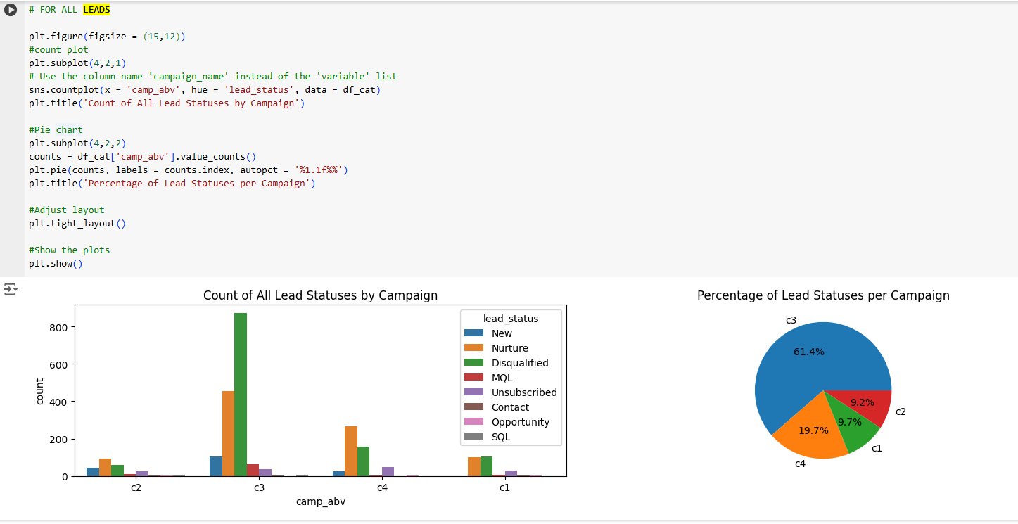
ALL LEAD STATUSES - DATA VISUALIZATION
C3
>
C4
>
C1
>
C2

Slide 14
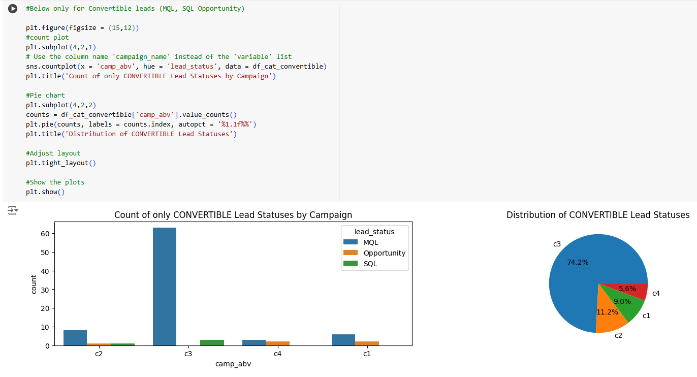
‘CONVERTIBLE’ LEAD STATUSES - DATA VISUALIZATION
C3
>
C2
>
C1
>
C4

Slide 15
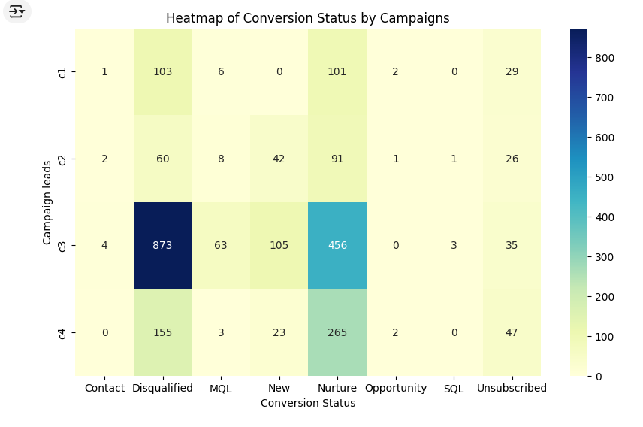
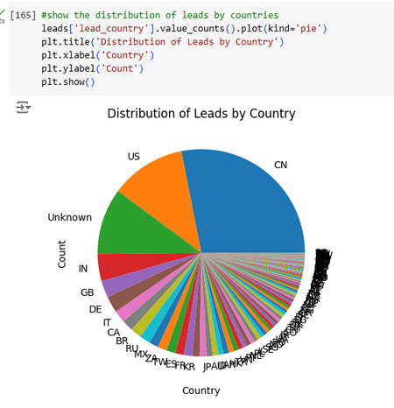
CAMPAIGN PERFORMANCE ANALYSIS - CONTD..
What's Working:
Distributed population: Good dispersion in terms of global engagement comprising users from various countries and sources (Google, Facebook, Twitter, LinkedIn, etc).
High ‘Nurture’ leads: high number of Nurture leads indicate user’s interest in moving to further stages in the market sales funnel thereby leading to possible conversions.
High Page views: avg page views for each campaign is comparatively good (402-9280), given the dataset size, which can be tapped to lead to more possible conversions.
What's Not Working:
High Bounce rates: high average bounce rate across all campaigns suggests lower user attention span on the portal. UI restructuring (button placement, catchy title, etc.) could help.
High ‘Disqualified’ leads: very high no of lost leads under ‘Disqualified’ and ‘Unsubscribed’ categories, targeting these segments should be prioritized.
Hindered Source Effectiveness: lots of high conversion leads have missing source information. Its crucial to identify marketing areas for highest-performing sources.
Low segmental optimization: owing to the low average time spent on the pages, there’s not much customer-centric content on the campaign pages, which must be tailored.

Slide 16
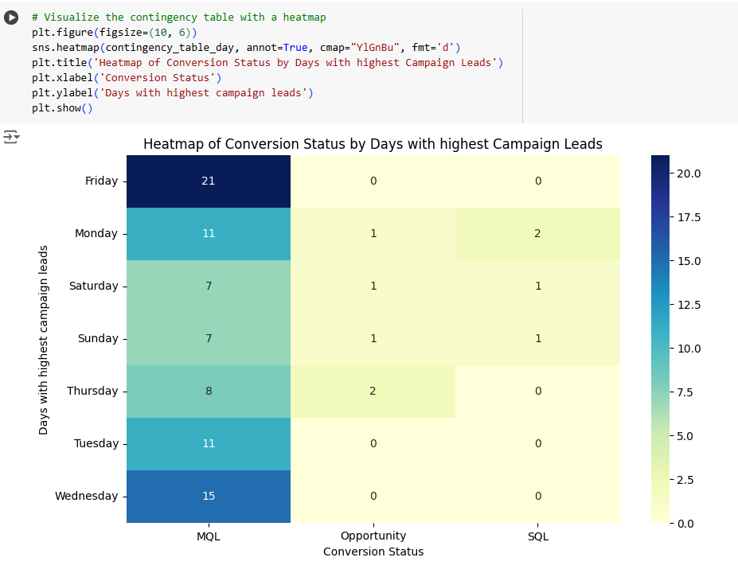
CAMPAIGN PERFORMANCE ANALYSIS - CONTD..
Campaign 1: FY19_IOT_Robotics_Whitepaper_OSconsiderations
Pros: 2nd least no of ‘Disqualified’ leads (155)
Cons: 3rd in page views, bounce rate, and leads
Campaign 2: CY20_IOT_Robotics_Whitepaper_ROSonrobotics
Pros: Least no of ‘Disqualified’ leads (60), 2nd in highest convertible leads (MQL, SQL, Opportunity)
Cons: Least page views and overall leads
Campaign 3: CY21_IOT_Robotics_T1_WP_ROSDocker
Pros: Best performer in page views (37122) and no of leads (1539)
Cons: Highest no of ‘Disqualified’ leads
Campaign 4: CY21_IOT_Robotics_Whitepaper_ROSESM
Pros: 2nd best campaign in page views (495) and no of leads (9630)
Cons: Least no of ‘Convertible’ Leads (MQL, SQL, Opportunity)

Slide 17

BYTES OF INSIGHTS
Campaign Performance
Seasonality and Exposure
Hot/Cold
Days
Social
Demographics
#1 Campaign - C3
Nov and Dec
Mon, Wed, Weekend
Student, Engineer
CY21_IOT_Robotics_T1_WP_ROSDocker
Best months
For better converts
Top titles for leads
C3 emerged as the most effective campaign in generating opportunistic and overall leads, with a good mix of paid, organic, and unknown lead sources.
November and December are top-performing months going by campaign joining dates and page viewing dates.
May, July, Sept, Aug, Oct are relatively slower months.
Weekends fared better for sales leads, and Monday, Wed, Fri performed better for Opportunities and Marketing Qualified Leads.
Top professions which have highest leads for ROS in the dataset.
#4 Campaign C1
1500 - 2500 & 37000-37499
Thursday, Tuesday
CN, US, IN
Needs more work
Highest lost leads
Top lead countries
Campaigns 1 & 2 –(FY19_IOT_Robotics_Whitepaper_Osconsiderations and CY20_IOT_Robotics_Whitepaper_ROSonrobotics) relatively fared similarly poorly throughout all the metrics of effectives - page views, leads, successful conversions, etc.
Optimal page views
Thursday and Tuesday saw the highest number of ‘Disqualified’ and ‘Unsubscribed’ leads.
These countries make the top 4 countries for overall leads, 3rd being the ‘Unknown’ category, making up for the missing data.
The ‘sweet spot’ ranges for optimal number of pageviews for a campaign to secure conversions is 1500-2500 and 37000-37499.

Slide 18
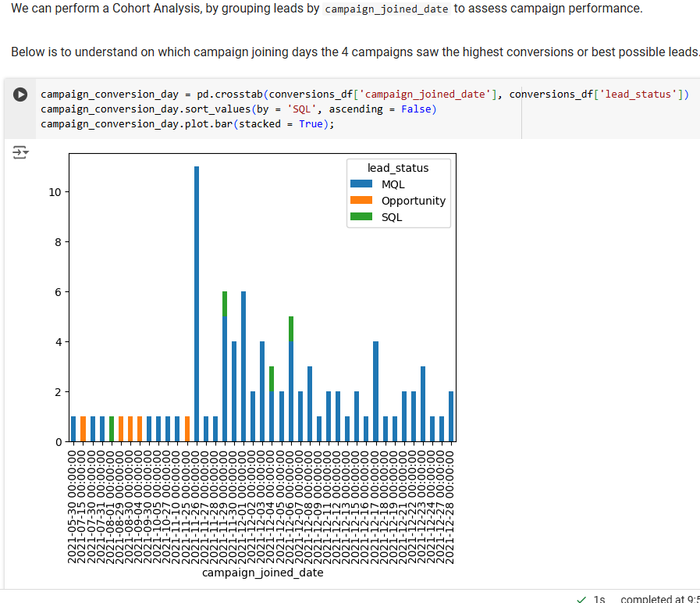
RECOMMENDATIONS
Improve data quality
Streamline data collection pipelines to capture qualitative data for critical fields (lead sources, country, industry, etc.)
Improve industry specific data to target domain-specific demand for ROS.
Content optimization
Based on the average time spent on pages, adjust the content to enhance segmented user engagement.
For pages with high bounce rates and low time on page, consider revising the content to better match user expectations.
Source effectiveness
Evaluate lead_source to identify which channels are driving the most conversions.
Focus marketing spend on the highest-performing sources.
Leverage Seasonality trends
Customized content centered on seasonality theme may attract conversions.
Consider allocating more marketing budget to months with higher conversions and engagement (Nov, Dec in this case) to maximize ROI.
Structure subscription offers and discounts for festive months to get people to spend more time on the portal.

Slide 19
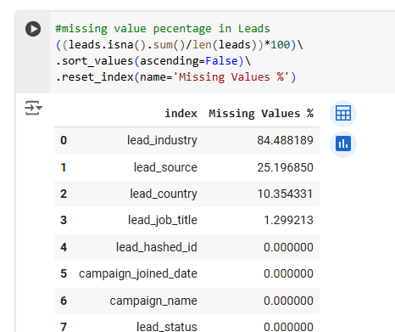
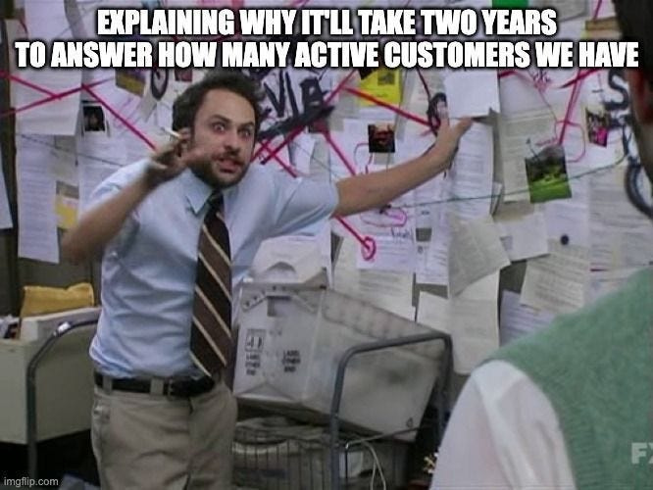
FUTURE DATA ANALYSIS STRATEGIES
Additional Data Needed:
Customer data:
Lead Interaction Data: Details on how leads interact with the campaign (e.g., clicks, downloads).
Lead Score: A calculated value based on various factors to prioritize leads.
Customer Feedback: Gather direct insights to improve campaign quality.
Revenue Data collection:
Campaign Cost: gather pricing related data (e.g., cost-per-campaign) to evaluate cost-effectiveness of the campaigns to track expenses to calculate ROI.
Customer Lifetime Value (CLTV): Estimate the potential revenue generated by each lead.

Slide 20
CONCLUSION
Analyse
Compare
Quantify
Monitor
Commercialize
data
baseline
metrics
market
revenue
Began with analysis of all datasets and chose appropriate ways of handling and cleaning to obtain a final dataset with all quantifiable columns for improved analysis.
Comparison on basis of baseline metrics such as leads, page views, seasonality trends, etc.
Undertake cross-testing and inferential statistical analysis to obtain actually significant trackers of performance analysis for various marketing campaigns.
Understand the blockers, create A/B tests over a period of time to have an evidence-backed strategy planning about which campaigns need help and which are actually converting to revenue.
Work on suggested data strategies to focus on areas like profit margin, cost-per-campaign, outreach mediums, etc., to increase revenue per campaign and savings.
By focusing on both engagement and lead quality metrics, we have determined what’s working and what’s not, and now need to implement data-driven changes for future campaigns.

Slide 21
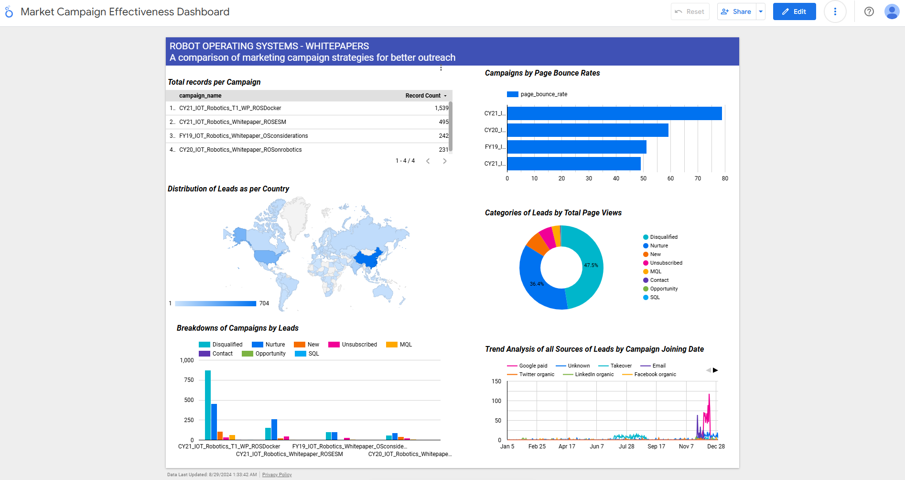
https://lookerstudio.google.com/reporting/5850c1c0-f930-4895-9ffd-0d77aa2b9f13

Slide 22
Join us in revolutionizing access to ‘Robotic’ ideas and emerging technologies.

Slide 23

Thank you!

